Slide 1
DDS Tone Shield
By Douglas Bahr
Engineer Accelerator
Fall Session 2016

Slide 2
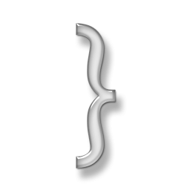
Topic Overview
Project Scope
The Development process
Project Results
Future Work

Slide 3
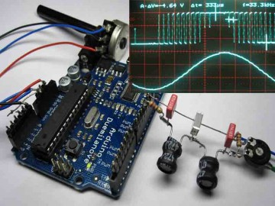
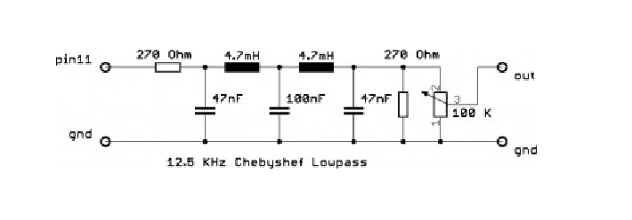
Start With Open Hardware
Arduino DDS Sinewave Generator
Martin Nawrath

Slide 4
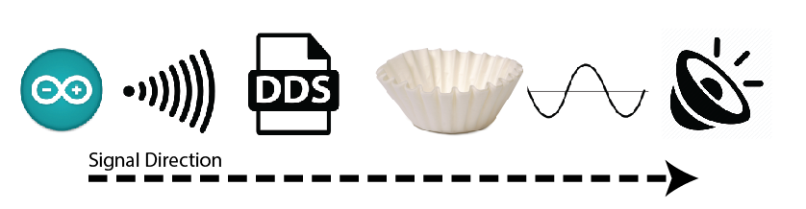
Project Goal

Slide 5
Focused Areas of Improvement
Part Arrangement
Programming
Frequency Range
Arduino Shield
Code Offload
20-20KHz
Free Hanging
Arduino Uno
20-16 KHz

Slide 6
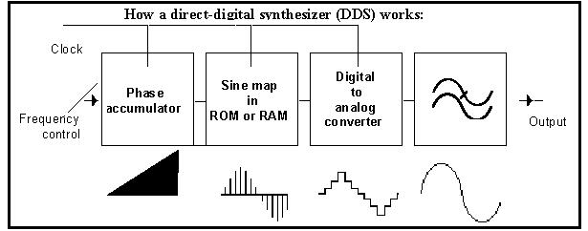
Direct Digital Synthesis

Slide 7
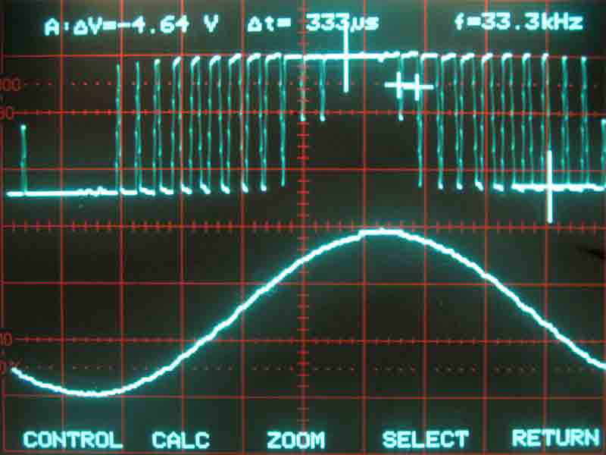
Direct Digital Synthesis

Slide 8
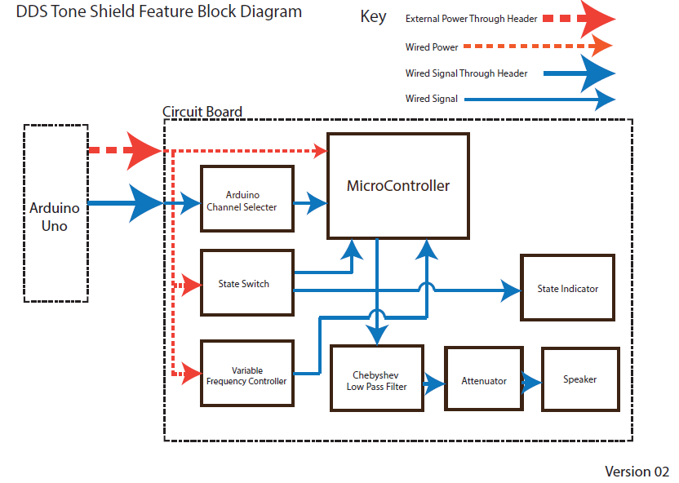
Product Definition

Slide 9
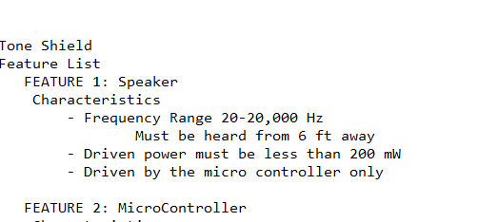
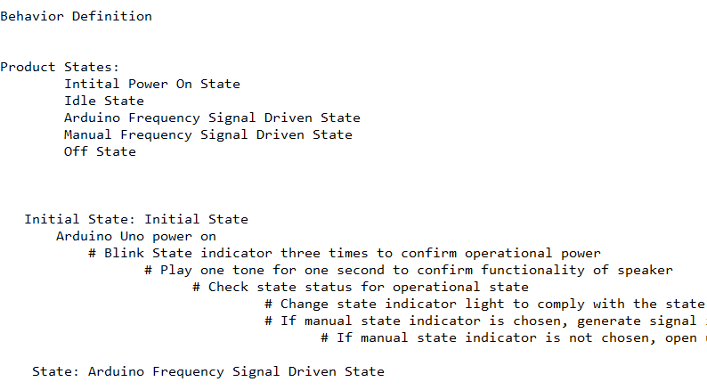
Feature & Behavior Definition

Slide 10
Update Schematic Calculation

Slide 11
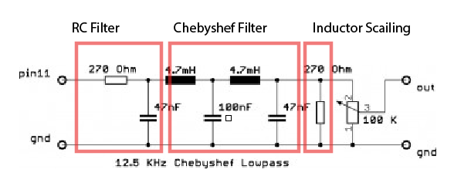
Update Schematic Calculation

Slide 12
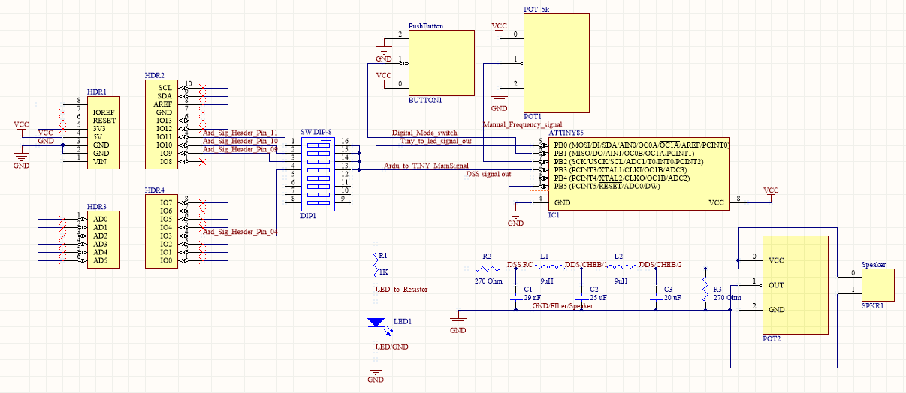
Schematic

Slide 13
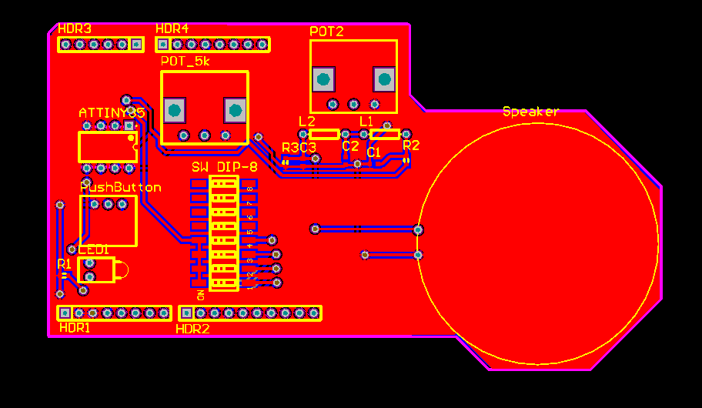
Board layout

Slide 14
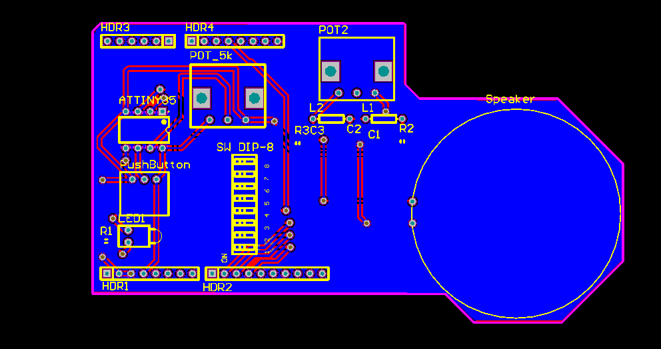
Board layout

Slide 15
Going Forward
Testing Cycle
Create Test define documents
Go Through Testing
Code Development
Create simple Arduino Library
Bring Up
Find the Empirical values of new filter

Slide 16
Final Take Away
Personal Time Management
Problem Scoping
Bogged down in details: Altium

Slide 17
Thank You!

